Slide 1

8th Grade Math: Pre-Algebra
Unit 4, Lesson 2 Generating Equivalent Numerical Expressions Volume 1, pg. 129

Slide 2


Benchmark
MA.8.NSO.1.3
Extend previous understanding of the Laws of Exponents to include integer exponents. Apply the Laws of Exponents to evaluate numerical expressions and generate equivalent numerical expressions, limited to integer exponents and rational number bases, with procedural fluency.
volume 1, pg. 129

Slide 3
Integrated Mathematical Thinking and Reasoning Standards
MA.K12.MTR.2.1 Demonstrate understanding by representing problems in multiple ways.
MA.K12.MTR.3.1 Complete tasks with mathematical fluency.
MA.K12.MTR.5.1 Use patterns and structure to help understand and connect mathematical concepts.
volume 1, pg. 129

Slide 4

Learning Target
I can generate equivalent numerical expressions for an expression with a rational base and integer exponent by applying the law of exponents.
volume 1, pg. 129

Slide 5

Warm-Up
volume 1, pg. 130

Slide 6
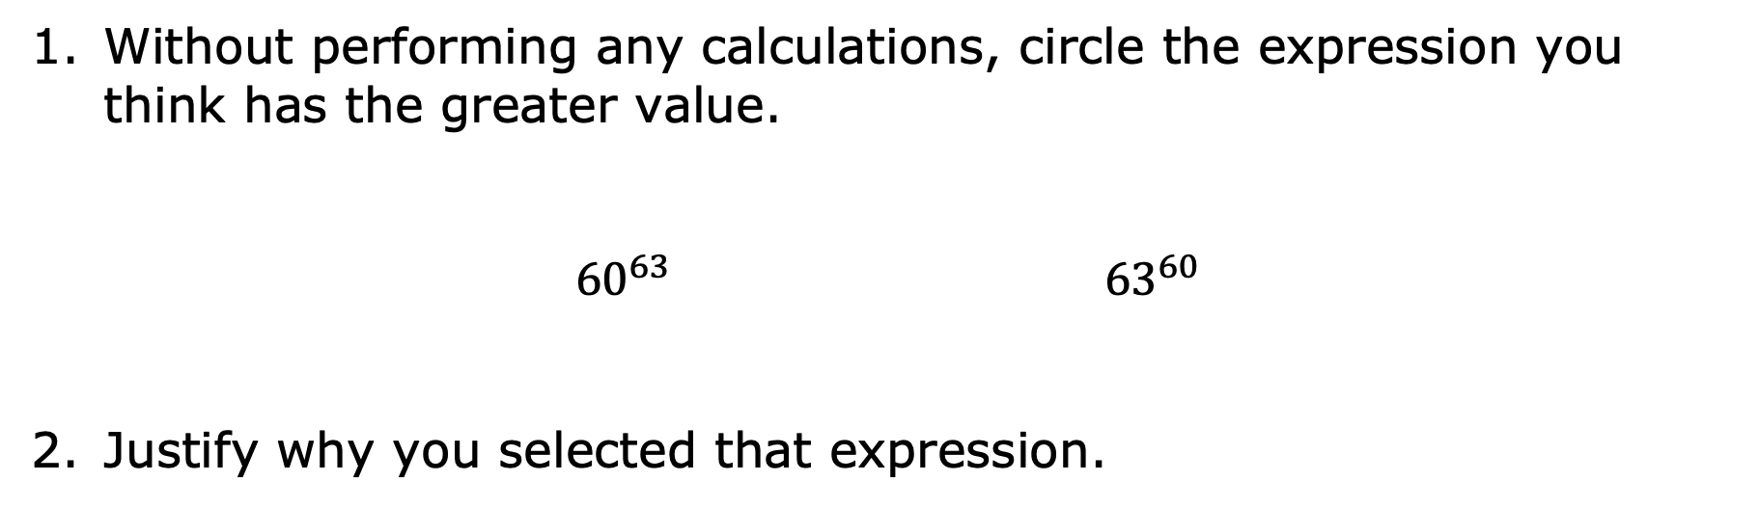
4.2.1 Warm-Up: Math Argument
Without performing any calculations, circle the expression you think has the greater value.
$${60}^{63} {63}^{60}$$
Justify why you selected that expression.
volume 1, pg. 130
Notes:
Video Link: https://algebranation.wistia.com/medias/fi4fidi5y8

Slide 7

Guided Instruction
volume 1, pg. 130

Slide 8

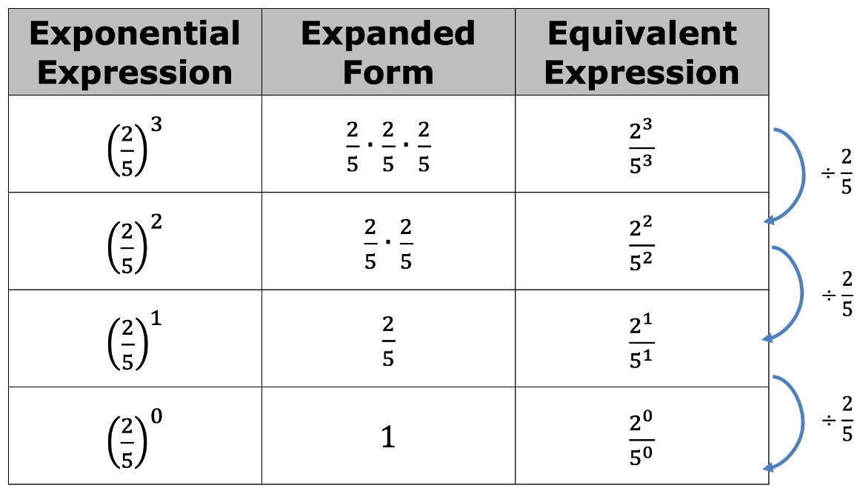
4.2.2 Guided Instruction: Rational Number Bases
Consider the table shown.
volume 1, pg. 130

Slide 9
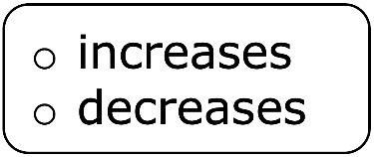

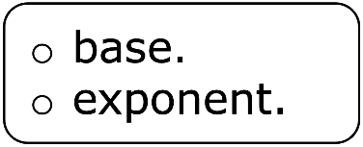
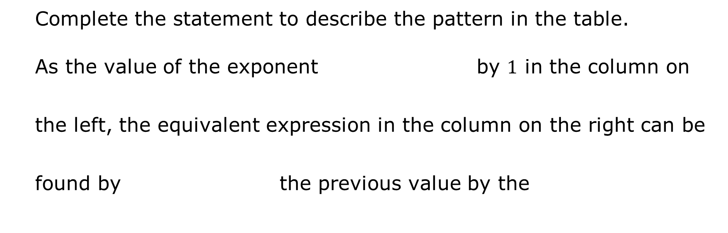
Complete the statement to describe the pattern in the table.
As the value of the exponent by $1$ in the column on the left, the equivalent expression in the column on the right can be found by the previous value by the
volume 1, pg. 130

Slide 10
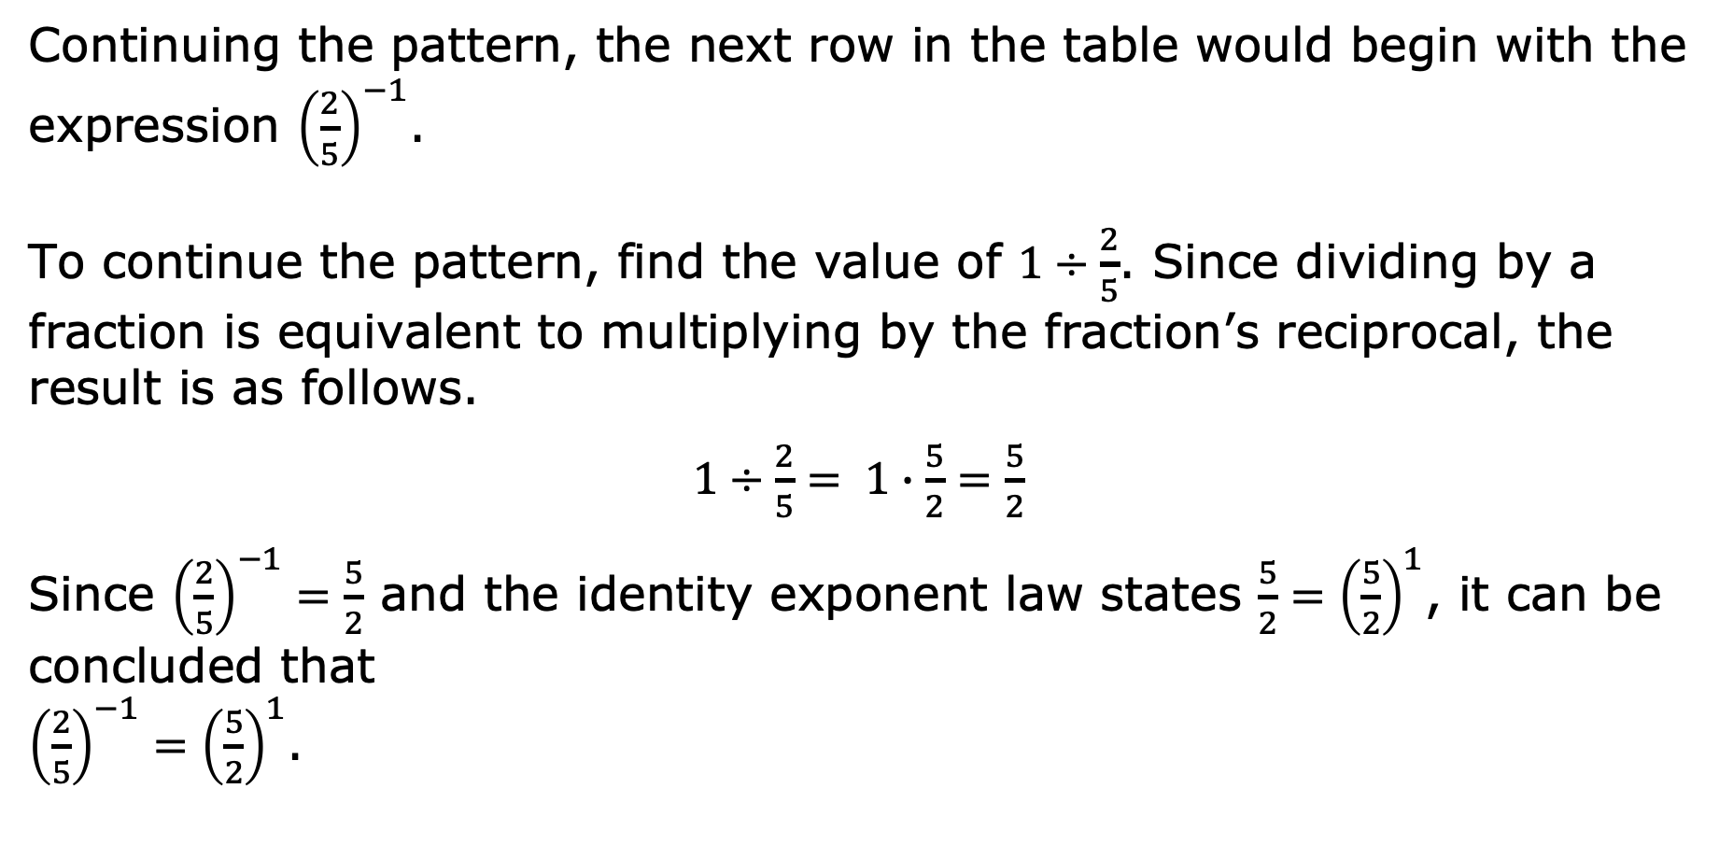
Continuing the pattern, the next row in the table would begin with the expression ${\left(\frac{2}{5}\right)}^{−1}$.
To continue the pattern, find the value of $1÷\frac{2}{5}$. Since dividing by a fraction is equivalent to multiplying by the fraction’s reciprocal, the result is as follows.
$1÷\frac{2}{5}= 1∙\frac{5}{2}=\frac{5}{2}$
Since ${\left(\frac{2}{5}\right)}^{−1}=\frac{5}{2}$ and the identity exponent law states $\frac{5}{2}={\left(\frac{5}{2}\right)}^{1}$, it can be concluded that
${\left(\frac{2}{5}\right)}^{−1}={\left(\frac{5}{2}\right)}^{1}$.
volume 1, pg. 131

Slide 11
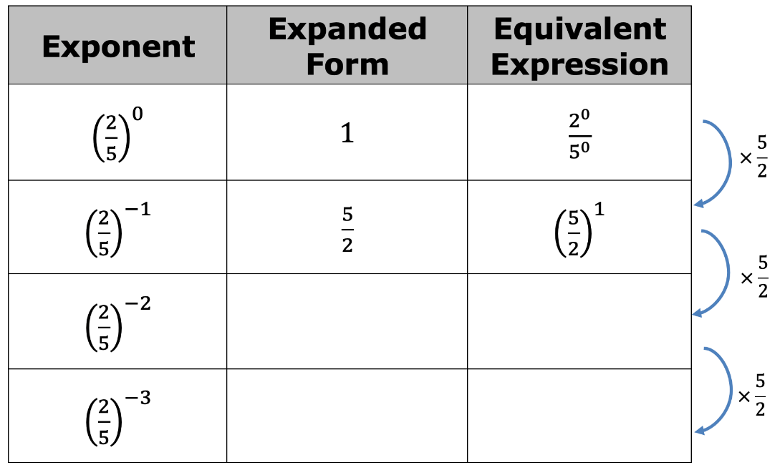
Continue the pattern.
volume 1, pg. 131

Slide 12
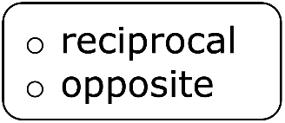
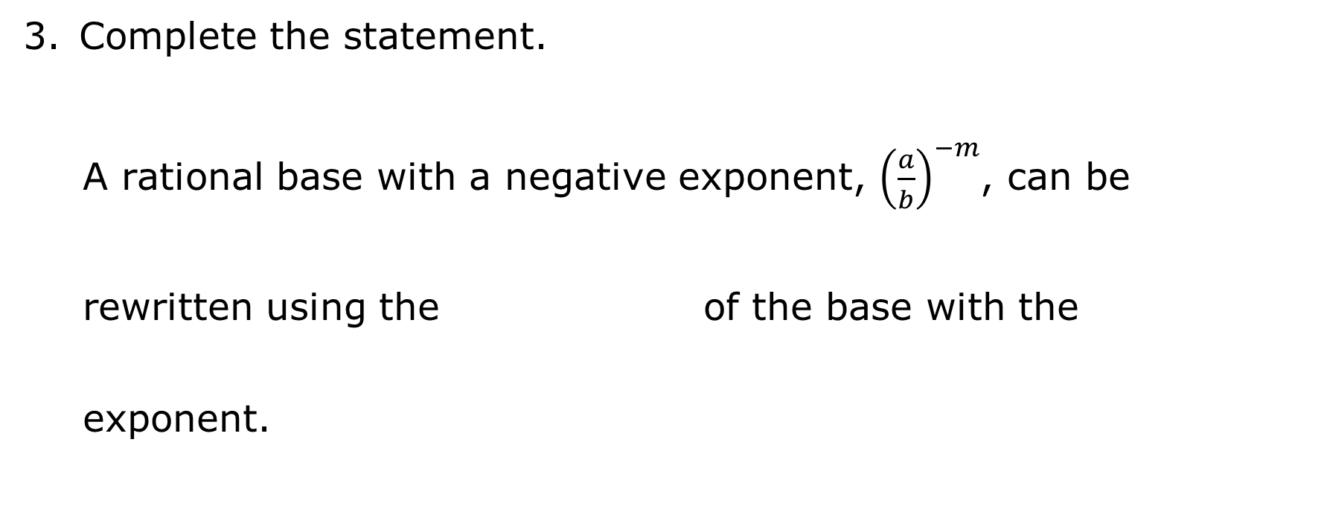
Complete the statement.
A rational base with a negative exponent, ${\left(\frac{a}{b}\right)}^{−m}$, can be rewritten using the of the base with the exponent.
volume 1, pg. 131

Slide 13

Rewrite each expression as an equivalent exponential expression with positive exponents.
a. ${\left(\frac{2}{3}\right)}^{−4}=______________$
b. ${\left(\frac{3}{−5}\right)}^{−9}=______________$
c. ${\left(−\frac{8}{9}\right)}^{−2}=______________$
d. ${\left(\frac{21}{4}\right)}^{−5}=______________$
volume 1, pg. 131

Slide 14

Guided Practice
volume 1, pg. 132

Slide 15

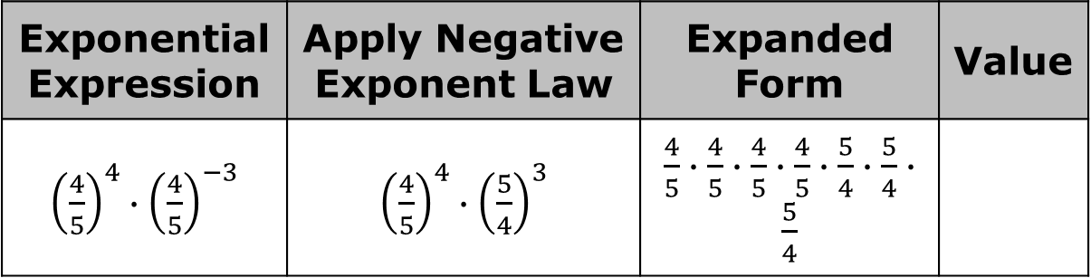
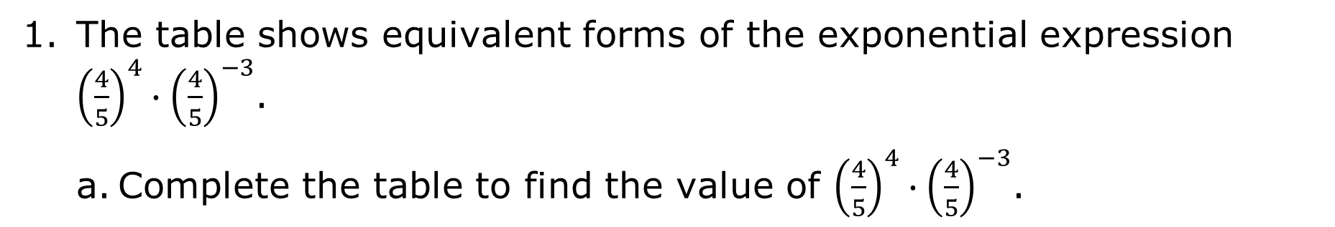
4.2.3 Guided Practice: Applying Multiple Exponent Laws to Expressions with Rational Bases
The table shows equivalent forms of the exponential expression ${\left(\frac{4}{5}\right)}^{4}∙{\left(\frac{4}{5}\right)}^{−3}$.
Complete the table to find the value of ${\left(\frac{4}{5}\right)}^{4}∙{\left(\frac{4}{5}\right)}^{−3}$.
Exponential Expression | Apply Negative Exponent Law | Expanded Form | Value
${\left(\frac{4}{5}\right)}^{4}∙{\left(\frac{4}{5}\right)}^{−3}$ | ${\left(\frac{4}{5}\right)}^{4}∙{\left(\frac{5}{4}\right)}^{3}$ | $\frac{4}{5}∙\frac{4}{5}∙\frac{4}{5}∙\frac{4}{5}∙\frac{5}{4}∙\frac{5}{4}∙\frac{5}{4}$
volume 1, pg. 132

Slide 16
Explain how you used the expanded form of the expression to determine the value.
volume 1, pg. 132

Slide 17
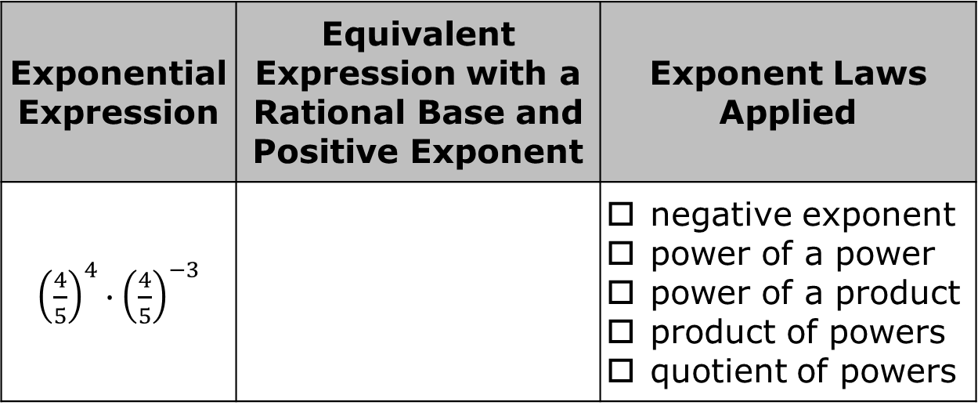
Multiple exponent laws can be applied to write equivalent forms of exponential expressions and to evaluate them.
For each expression, apply one or more exponent laws to rewrite as an equivalent expression with a rational base and positive exponent. Check off the exponent law(s) you applied to generate the expression. Show your work.
Exponential Expression | Equivalent Expression with a Rational Base and Positive Exponent | Exponent Laws Applied
${\left(\frac{4}{5}\right)}^{4}∙{\left(\frac{4}{5}\right)}^{−3}$ |  | negative exponent power of a power power of a product product of powers quotient of powers
volume 1, pg. 132

Slide 18
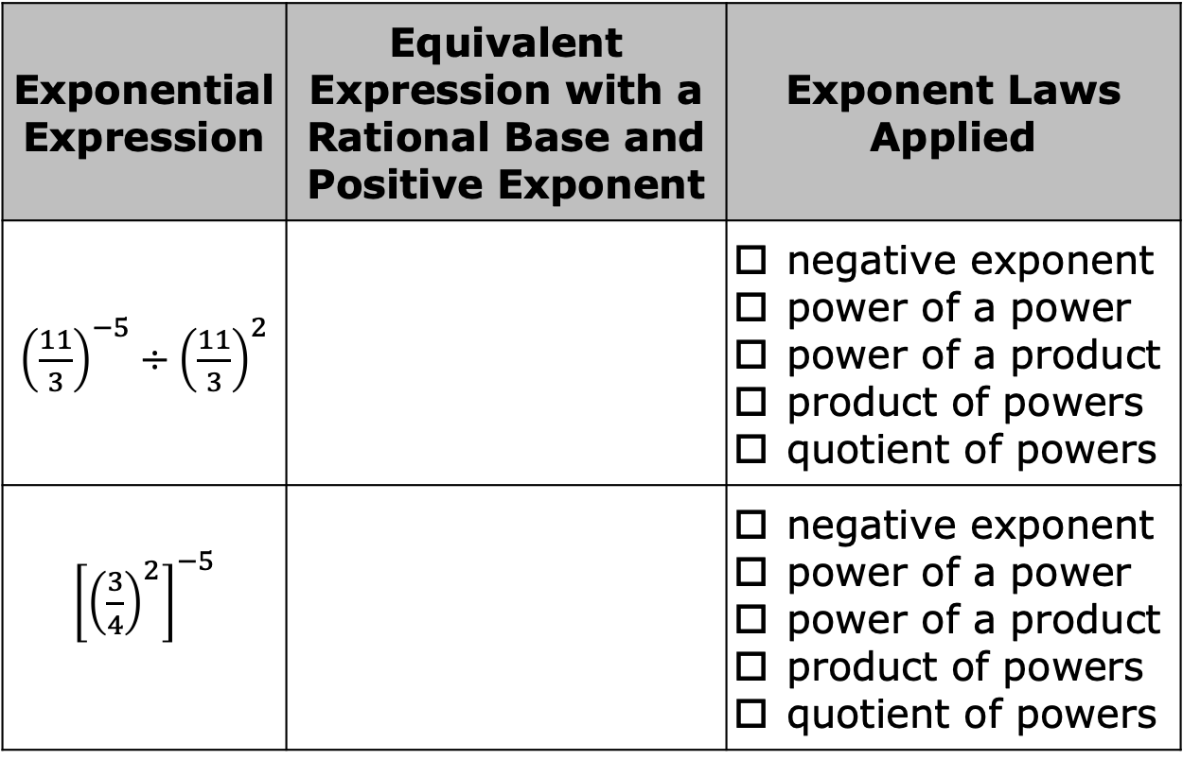
Exponential Expression | Equivalent Expression with a Rational Base and Positive Exponent | Exponent Laws Applied
${\left(\frac{11}{3}\right)}^{−5}÷{\left(\frac{11}{3}\right)}^{2}$ |  | negative exponent power of a power power of a product product of powers quotient of powers
${\left[{\left(\frac{3}{4}\right)}^{2}\right]}^{−5}$ |  | negative exponent power of a power power of a product product of powers quotient of powers
volume 1, pg. 132

Slide 19
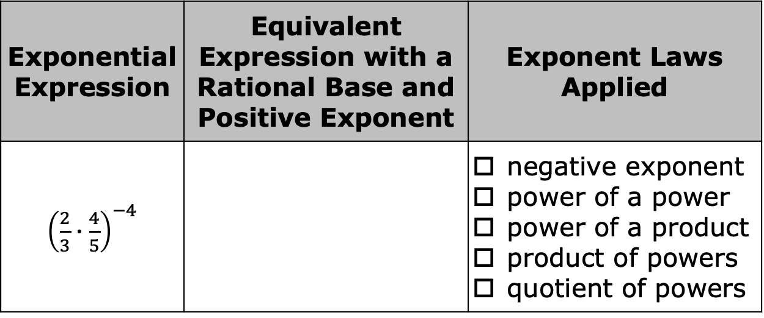
Exponential Expression | Equivalent Expression with a Rational Base and Positive Exponent | Exponent Laws Applied
${\left(\frac{2}{3}∙\frac{4}{5}\right)}^{−4}$ |  | negative exponent power of a power power of a product product of powers quotient of powers
volume 1, pg. 132

Slide 20

Collaboration
volume 1, pg. 133

Slide 21

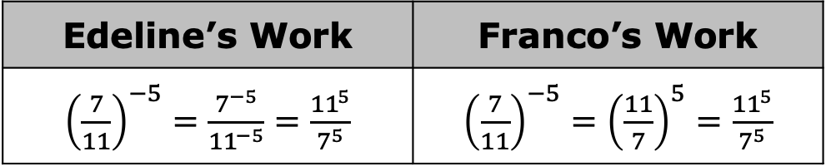
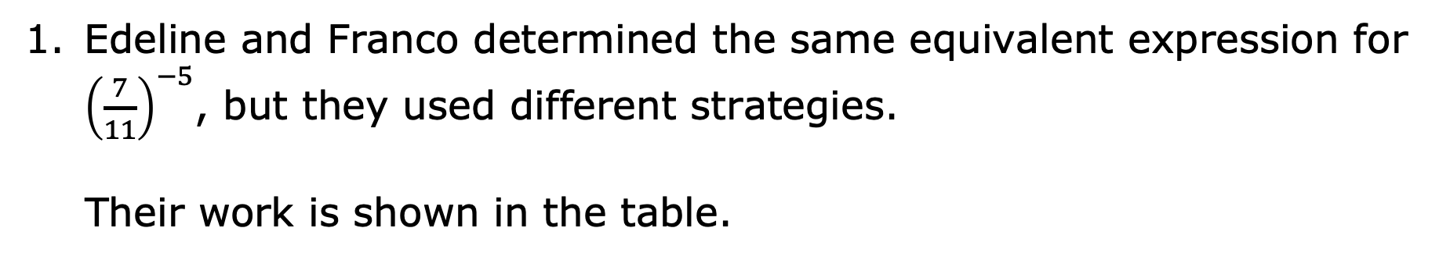
4.2.4 Collaboration: Comparing Strategies
Edeline and Franco determined the same equivalent expression for ${\left(\frac{7}{11}\right)}^{−5}$, but they used different strategies.
Their work is shown in the table.
Edeline’s Work | Franco’s Work
${\left(\frac{7}{11}\right)}^{−5}=\frac{7^{−5}}{{11}^{−5}}=\frac{{11}^{5}}{7^{5}}$ | ${\left(\frac{7}{11}\right)}^{−5}={\left(\frac{11}{7}\right)}^{5}=\frac{{11}^{5}}{7^{5}}$
volume 1, pg. 133

Slide 22
Discuss both students’ strategies with your partner.
What steps did Edeline take to find the equivalent expression?
What steps did Franco take to find the equivalent expression?
Whose method do you prefer?
volume 1, pg. 133

Slide 23

Your Turn
volume 1, pg. 133

Slide 24
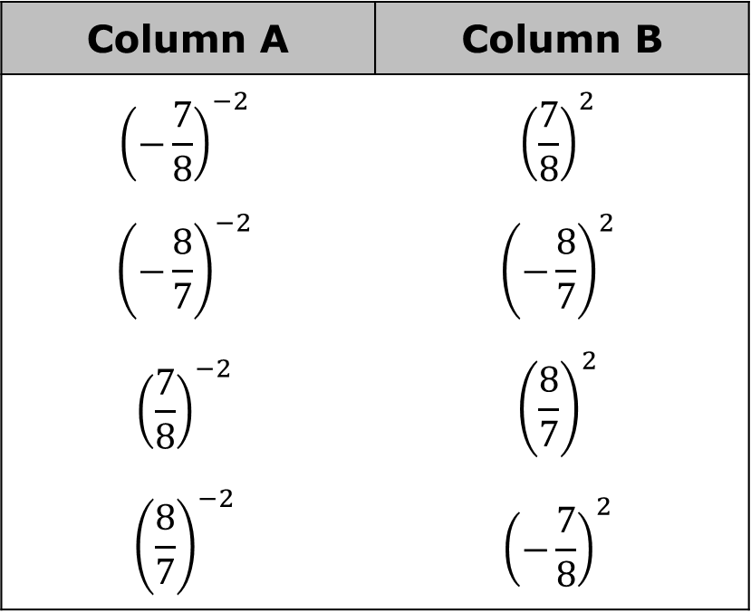
4.2.5 Your Turn!
Match each expression in Column A to an equivalent expression in Column B by drawing arrows.
Column A | Column B
$${\left(−\frac{7}{8}\right)}^{−2}$$ | $${\left(\frac{7}{8}\right)}^{2}$$
$${\left(−\frac{8}{7}\right)}^{−2}$$ | $${\left(−\frac{8}{7}\right)}^{2}$$
$${\left(\frac{7}{8}\right)}^{−2}$$ | $${\left(\frac{8}{7}\right)}^{2}$$
$${\left(\frac{8}{7}\right)}^{−2}$$ | $${\left(−\frac{7}{8}\right)}^{2}$$
volume 1, pg. 133

Slide 25
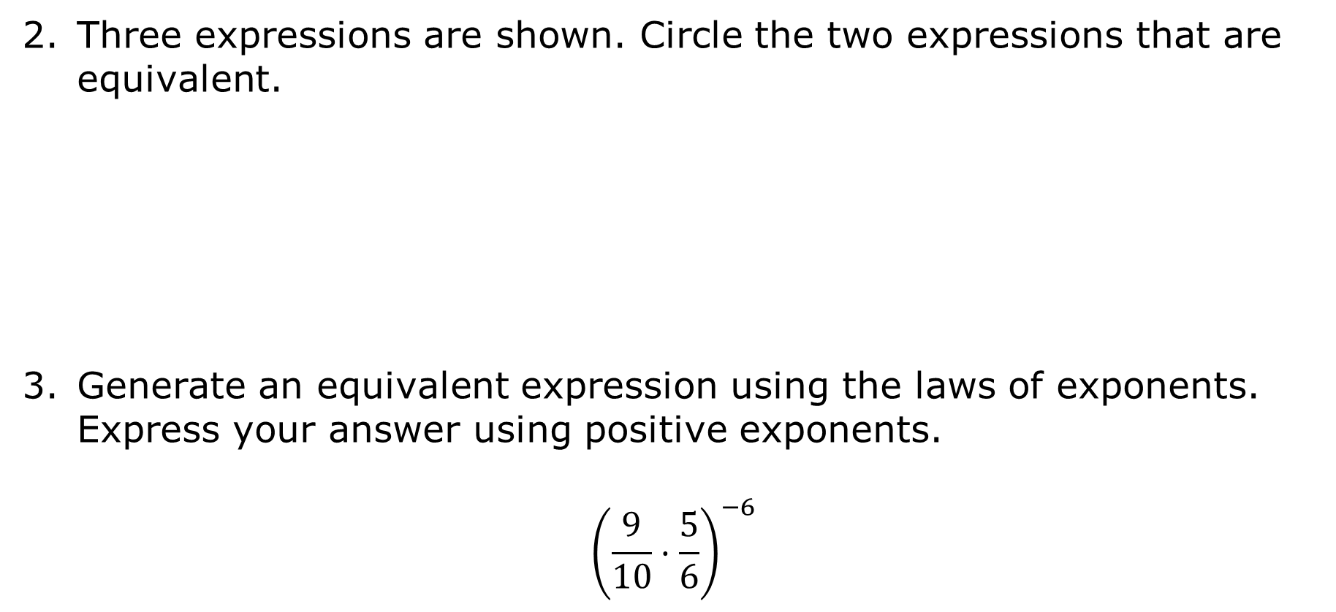
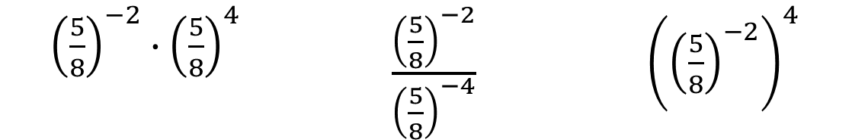
Three expressions are shown. Circle the two expressions that are equivalent.
Generate an equivalent expression using the laws of exponents. Express your answer using positive exponents.
$${\left(\frac{9}{10}·\frac{5}{6}\right)}^{−6}$$
${\left(\frac{5}{8}\right)}^{−2}∙{\left(\frac{5}{8}\right)}^{4}$ | $\frac{{\left(\frac{5}{8}\right)}^{−2}}{{\left(\frac{5}{8}\right)}^{−4}}$ | ${\left({\left(\frac{5}{8}\right)}^{−2}\right)}^{4}$
volume 1, pg. 133

Slide 26

Wrap-Up
volume 1, pg. 134

Slide 27
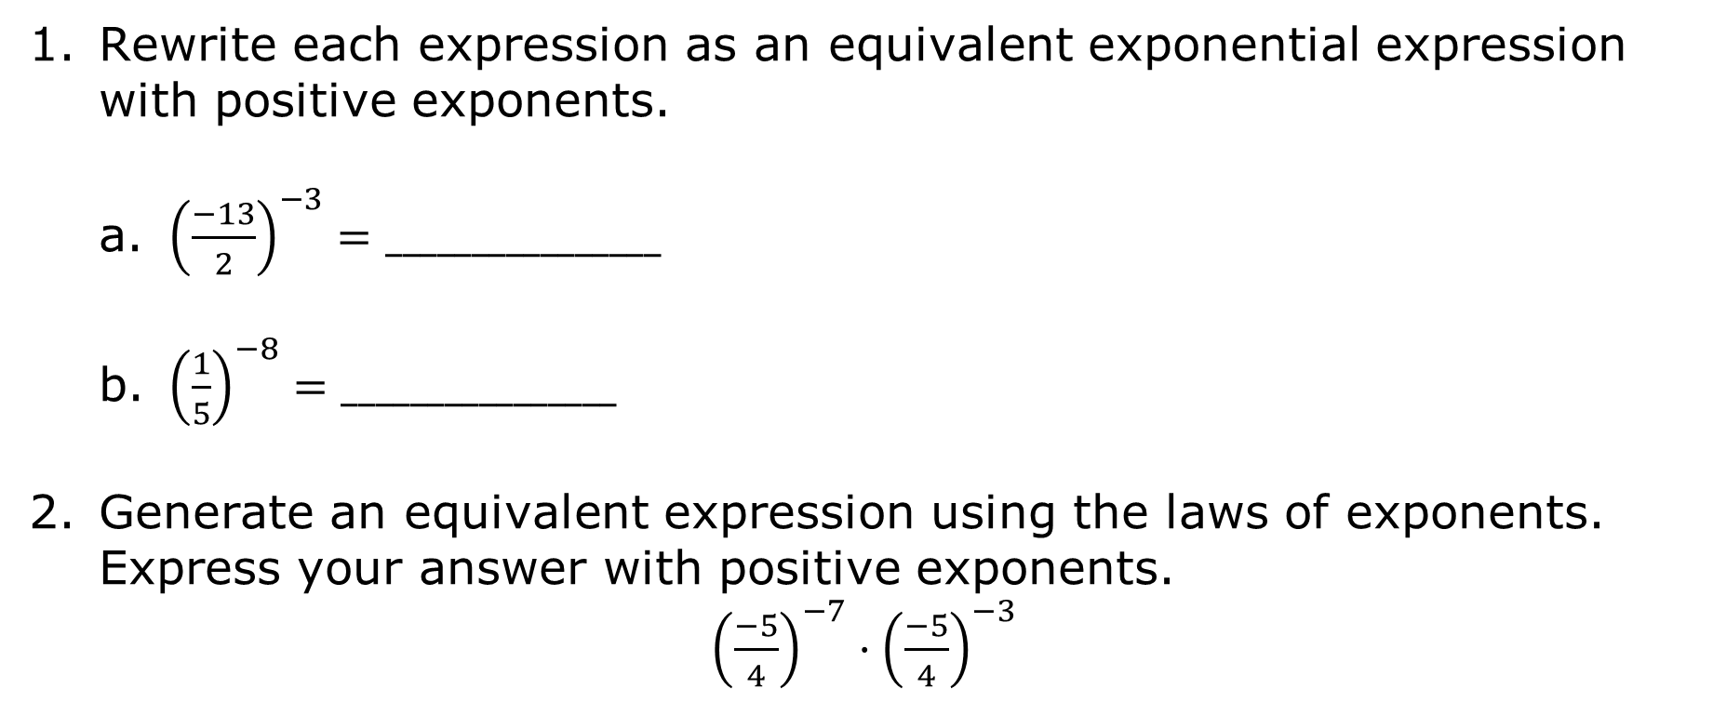
4.2.6 Wrap-Up: Ticket Out the Door
Rewrite each expression as an equivalent exponential expression with positive exponents.
a. ${\left(\frac{−13}{2}\right)}^{−3}=________________$
b. ${\left(\frac{1}{5}\right)}^{−8}=________________$
Generate an equivalent expression using the laws of exponents. Express your answer with positive exponents.
${\left(\frac{−5}{4}\right)}^{−7}·{\left(\frac{−5}{4}\right)}^{−3}$
volume 1, pg. 134

